Slide 1
Structure Programming
ICT-1105
Information and Communication Technology
Lecture-18
Date:

Slide 2
Class contents has given in Google Classroom with code
nhauiw4

Slide 3
Pointers

Slide 4
NULL Pointer
A pointer that is not assigned any value but NULL is known as NULL pointer. If you don't have any address to be specified in the pointer at the time of declaration, you can assign NULL value.
Or

Slide 5
NULL Pointer
It is always a good practice to assign a NULL value to a pointer variable in case you do not have an exact address to be assigned. This is done at the time of variable declaration.
A pointer that is assigned NULL is called a null pointer.
int *p=NULL;
Note: The NULL pointer is a constant with a value of zero defined in several standard libraries/ in most the libraries, the value of pointer is 0 (zero)

Slide 6
NULL Pointer
It is always a good practice to assign a NULL value to a pointer variable in case you do not have an exact address to be assigned. This is done at the time of variable declaration.
A pointer that is assigned NULL is called a null pointer.
int *p=NULL;
Note: The NULL pointer is a constant with a value of zero defined in several standard libraries/ in most the libraries, the value of pointer is 0 (zero)

Slide 7
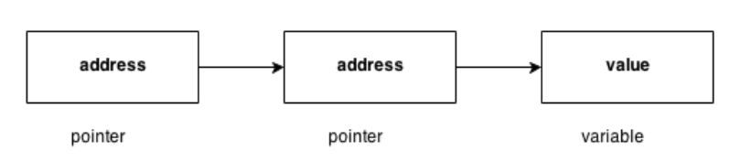
Pointers to Pointers
Pointers can point to other pointers /pointer refers to the address of another pointer.
pointer can point to the address of another pointer which points to the address of a value.

Slide 8
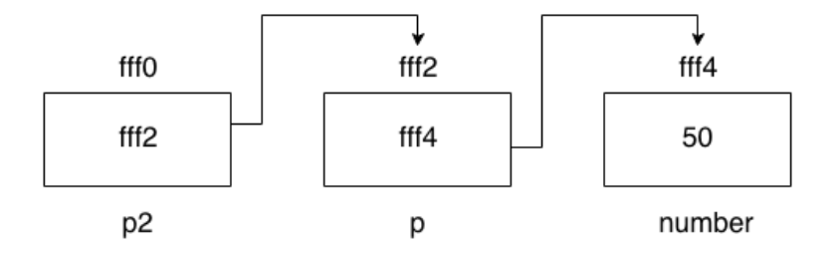
Pointers to Pointers
syntax of pointer to pointer
int **p2;
pointer to pointer example
Let's see an example where one pointer points to the address of another pointer.

Slide 9
Pointers to Pointers
#include <stdio.h>
#include <conio.h>
void main()
{
int number=50;
int *p; //pointer to int
int **p2; //pointer to pointer
p=&number; //stores the address of number variable
p2=&p;
printf("Address of number variable is %x \n",&number);
printf("Address of p variable is %x \n",p);
printf("Value of *p variable is %d \n",*p);
printf("Address of p2 variable is %x \n",p2);
printf("Value of **p2 variable is %d \n",**p);
getch();
}

Slide 10
Pointers to Pointers
Output
Address of number variable is fff4
Address of p variable is fff4
Value of *p variable is 50
Address of p2 variable is fff2
Value of **p variable is 50

Slide 11
Arrays and Pointers
When an array is declared, compiler allocates sufficient amount of memory to contain all the elements of the array. Base address which gives location of the first element is also allocated by
the compiler.
Suppose we declare an array arr,
int arr[5]={ 1, 2, 3, 4, 5 };

Slide 12
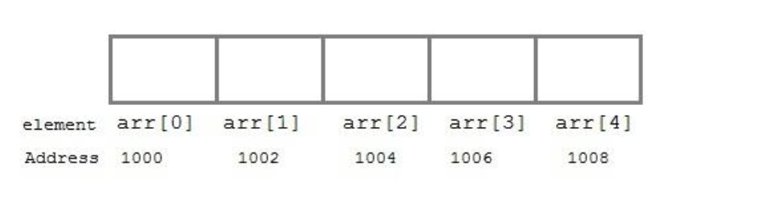
Arrays and Pointers
Assuming that the base address of arr is 1000 and each integer requires two byte, the five element will be stored as follows

Slide 13
Arrays and Pointers
Here variable arr will give the base address, which is a constant pointer pointing to the element, arr[0]. Therefore arr is containing the address of arr[0] i.e 1000.
arr is equal to &arr[0] // by default

Slide 14
Arrays and Pointers
We can declare a pointer of type int to point to the array arr.
int arr[5]={ 1, 2, 3, 4, 5 };
int *p;
p = arr;
or p = &arr[0]; //both the statements are equivalent.
Now we can access every element of array arr using p++ to move from one element to another.
NOTE : You cannot decrement a pointer once incremented. p-- won't work.

Slide 15
Pointer to Array
we can use a pointer to point to an Array, and then we can use that pointer to access the array.
Lets have an example,
int i;
int a[5] = {1, 2, 3, 4, 5};
int *p = a; // same as int*p = &a[0]
for (i=0; i<5; i++)
{
printf("%d", *p);
p++;
}

Slide 16
Pointer to Array
In the previous program, the pointer *p will print all the values stored in the array one by one. We can also use the Base address (a in previous case) to act as pointer and print all the values.

Slide 17
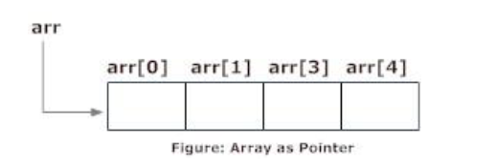
Relation between Arrays and Pointers
Consider an array:
int arr[4];
n C programming, name of the array always points to address of the first element of an array.
In the above example, arr and &arr[0] points to the address of the first element.
&arr[0] is equivalent to arr
Since, the addresses of both are the same, the values of arr and &arr[0] are also the same.
arr[0] is equivalent to *arr (value of an address of the pointer)

Slide 18
Relation between Arrays and Pointers
Similarly,
&arr[1] is equivalent to (arr + 1) AND, arr[1] is equivalent to *(arr + 1).
&arr[2] is equivalent to (arr + 2) AND, arr[2] is equivalent to *(arr + 2).
&arr[3] is equivalent to (arr + 3) AND, arr[3] is equivalent to *(arr + 3).
.
.
&arr[i] is equivalent to (arr + i) AND, arr[i] is equivalent to *(arr + i).

Slide 19
Relation between Arrays and Pointers
Example: Program to find the sum of six numbers with arrays and pointers
#include <stdio.h>
int main()
{
int i, classes[6],sum = 0;
printf("Enter 6 numbers:\n");
for(i = 0; i < 6; ++i)
{
// (classes + i) is equivalent to &classes[i]
scanf("%d",(classes + i));
// *(classes + i) is equivalent to classes[i]
sum += *(classes + i);
}
printf("Sum = %d", sum);
return 0;
}

Slide 20
Relation between Arrays and Pointers
Output
Enter 6 numbers:
2
3
4
5
3
4
Sum = 21

Slide 21
Pointer Arithmetic and Arrays
pointer holds address of a value, so there can be arithmetic operations on the pointer variable.
There are four arithmetic operators that can be used on pointers:
o Increment(++)
o Decrement(--)
o Addition(+)
o Subtraction(-)

Slide 22
Increment pointer
1. Incrementing Pointer is generally used in array because we have contiguous memory in array and we know the contents of next memory location.
2. Incrementing Pointer Variable Depends Upon data type of the Pointer variable.
The formula of incrementing pointer is given below:
new_address= current_address + i * size_of(data type)

Slide 23
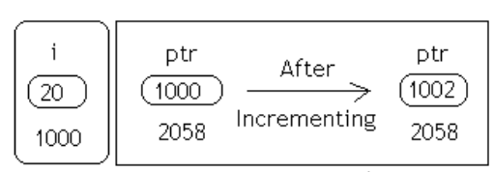

Increment pointer
Three rules should be used to increment pointer
Address + 1 = Address
Address++ = Address
++Address = Address
Pictorial representation

Slide 24
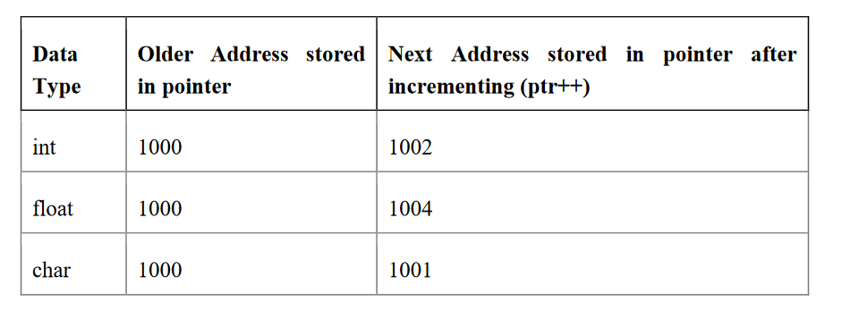
Increment pointer

Slide 25
Increment pointer
Example:
#include <stdio.h>
void main(){
int number=50;
int *p; //pointer to int
p=&number; //stores the address of number variable
printf("Address of p variable is %u \n",p);
p=p+1;
printf("After increment: Address of p variable is %u\n",p);
}

Slide 26
Decrement pointer
Like increment, we can decrement a pointer variable.
formula of decrementing pointer
new_address= current_address - i * size_of(data type)

Slide 27
Decrement pointer
Example:
#include <stdio.h>
void main(){
int number=50;
int *p;//pointer to int
p=&number;//stores the address of number variable
printf("Address of p variable is %u \n",p);
p=p-1;
printf("After decrement: Address of p variable is %u \n",p);
}

Slide 28
Addition pointer
We can add a value to the pointer variable.
Formula of adding value to pointer
new_address= current_address + (number * size_of(data type))

Slide 29
Addition pointer
Example:
#include <stdio.h>
void main(){
int number=50;
int *p;//pointer to int
p=&number;//stores the address of number variable
printf("Address of p variable is %u \n",p);
p=p+3; //adding 3 to pointer variable
printf("After adding 3: Address of p variable is %u \n",p);
}

Slide 30
Subtraction pointer
Like pointer addition, we can subtract a value from the pointer variable. The formula of subtracting value from pointer variable.
new_address= current_address - (number * size_of(data type))

Slide 31
Subtraction pointer
Example:
#include <stdio.h>
void main(){
int number=50;
int *p;//pointer to int
p=&number;//stores the address of number variable
printf("Address of p variable is %u \n",p);
p=p-3; //subtracting 3 from pointer variable
printf("After subtracting 3: Address of p variable is %u \n",p);
}

Slide 32
Passing an Array to a Function
If you want to pass a single-dimension array as an argument in a function, you would have to declare a formal parameter in one of following three ways and all three declaration methods produce similar results because each tells the compiler that an integer pointer is going to be received. Similarly, you can pass multi-dimensional arrays as formal parameters.

Slide 33
Passing an Array to a Function
1) Formal parameters as a pointer –
void myFunction(int *param) {
.
.
.
}
2) Formal parameters as a sized array –
void myFunction(int param[10]) {
.
.
.
}
3) Formal parameters as an unsized array −
void myFunction(int param[10]) {
.
.
.
}

Slide 34
Passing an Array to a Function
Example1: pass an entire array to a function argument
#include <stdio.h>
/* function declaration */
double getAverage(int arr[], int size);
int main () {
/* an int array with 5 elements */
int balance[5] = {1000, 2, 3, 17, 50};
double avg;
/* pass pointer to the array as an argument */
avg = getAverage( balance, 5 ) ;
/* output the returned value */
printf( "Average value is: %f ", avg );
return 0;
}

Slide 35
Passing an Array to a Function
double getAverage(int arr[], int size) {
int i;
double avg;
double sum = 0;
for (i = 0; i < size; ++i) {
sum += arr[i];
}
avg = sum / size;
return avg;
}
Output
Average value is: 214.400000

Slide 36
Passing an Array to a Function
Example2: pass an entire array to a function argument
#include <stdio.h>
myfuncn( int *var1, int var2)
{
for(int x=0; x<var2; x++)
{
printf("Value of var_arr[%d] is: %d \n", x, *var1);
/*increment pointer for next element fetch*/
var1++;
}
}

Slide 37
Passing an Array to a Function
int main()
{
int var_arr[] = {11, 22, 33, 44, 55, 66, 77};
myfuncn(&var_arr, 7);
return 0;
}

Slide 38
Passing an Array to a Function
Output
Value of var_arr[0] is: 11
Value of var_arr[1] is: 22
Value of var_arr[2] is: 33
Value of var_arr[3] is: 44
Value of var_arr[4] is: 55
Value of var_arr[5] is: 66
Value of var_arr[6] is: 77

Slide 39
Example: Call by value method
#include <stdio.h>
disp( char ch)
{
printf("%c ", ch);
}
int main()
{
char arr[] = {'a', 'b', 'c', 'd', 'e', 'f', 'g', 'h', 'I', 'j'};
for (int x=0; x<=10; x++)
{
/* I‟m passing each element one by one using subscript*/
disp (arr[x]);
}
return 0;
}
Output:
a b c d e f g h i j
In this method of calling a function, the actual arguments gets copied into formal arguments. In this example actual argument(or parameter) is arr[x] and formal parameter is ch.

Slide 40
Call by reference method: Using pointers
#include <stdio.h>
disp( int *num)
{
printf("%d ", *num);
}
int main()
{
int arr[] = {1, 2, 3, 4, 5, 6, 7, 8, 9, 0};
for (int i=0; i<=10; i++)
{
/* I‟m passing element‟s address*/
disp (&arr[i]);
}
return 0;
}
Output:
1 2 3 4 5 6 7 8 9 0

Slide 41
Array of Pointers
An array of pointers would be an array that holds memory locations.
An array of pointers is an indexed set of variables in which the variables are pointers (a reference to a location in memory).
Syntax:
data_type_name * variable name
Example
int *ptr[MAX];

Slide 42
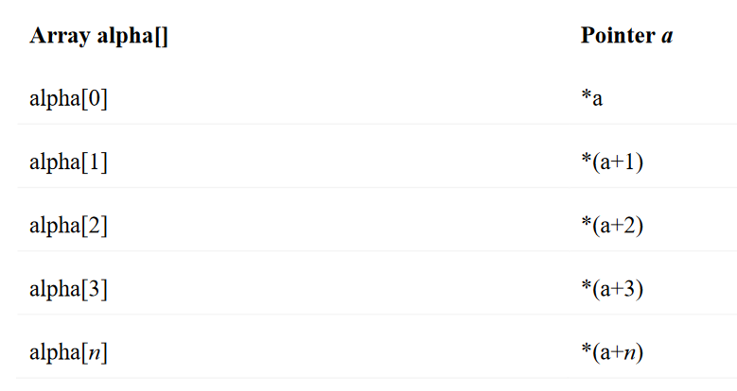
Array of Pointers

Slide 43
Array of Pointers
Example1:
#include <stdio.h>
const int MAX = 3;
int main () {
int var[] = {10, 100, 200};
int i, *ptr[MAX];
for ( i = 0; i < MAX; i++) {
ptr[i] = &var[i]; /* assign the address of integer. */
}
for ( i = 0; i < MAX; i++) {
printf("Value of var[%d] = %d\n", i, *ptr[i] );
}
return 0;
}

Slide 44
Array of Pointers
Output
Value of var[0] = 10
Value of var[1] = 100
Value of var[2] = 200

Slide 45
Array of Pointers
Example2:
#include <stdio.h>
#include <conio.h>
main() {
int *array[3];
int x = 10, y = 20, z = 30;
int i;
array[0] = &x;
array[1] = &y;
array[2] = &z;
for (i=0; i< 3; i++) {
printf("The value of %d= %d ,address is %u\t \n", i, *(array[i]), array[i]);
}
return 0;
}

Slide 46
Array of Pointers
Example3:
#include <stdio.h>
const int MAX = 4;
int main () {
char *names[] = {
"Zara Ali",
"Hina Ali",
"Nuha Ali",
"Sara Ali"
};
int i = 0;
for ( i = 0; i < MAX; i++) {
printf("Value of names[%d] = %s\n", i, names[i] );
}
return 0;
}

Slide 47
Array of Pointers
Output:
Value of names[0] = Zara Ali
Value of names[1] = Hina Ali
Value of names[2] = Nuha Ali
Value of names[3] = Sara Ali

Slide 48
Array of Pointers
Example4:
#include <stdio.h>
int main()
{
char *fruit[] = {
"watermelon",
"banana",
"pear",
"apple",
"coconut",
"grape",
"blueberry"
};
int x;
for(x=0;x<7;x++)
puts(fruit[x]);
C PROGRAMMING Page 221
return(0);
}

Slide 49
Pointers to Void and to Functions
Pointers to Void
Note:
1. Suppose we have to declare integer pointer, character pointer and float pointer then we need to declare 3 pointer variables.
2. Instead of declaring different types of pointer variable it is feasible to declare single pointer variable which can act as integer pointer, character pointer.

Slide 50
Pointers to Void and to Functions
Pointers to Void
A pointer variable declared using a particular data type can not hold the location address of variables of other data types. It is invalid and will result in a compilation error.
Ex:- char *ptr;
int var1;
ptr=&var1; // This is invalid because „ptr‟ is a character pointer variable.
Here comes the importance of a “void pointer”. A void pointer is nothing but a pointer variable declared using the reserved word in C “void”.

Slide 51
Pointers to Void and to Functions
Void Pointer Basics :
In C General Purpose Pointer is called as void Pointer.
It does not have any data type associated with it
It can store address of any type of variable
A void pointer is a C convention for a raw address.
The compiler has no idea what type of object a void Pointer really points to ?

Slide 52
Pointers to Void and to Functions
Void pointer: A void pointer is a pointer that has no associated data type with it. A void pointer can hold address of any type and can be type casted to any type. Special type of pointer called void pointer or general purpose pointer.
Declaration of void pointer
void * pointer_name;

Slide 53
Pointers to Void and to Functions
Void pointer example
void *ptr; // ptr is declared as Void pointer
char cnum;
int inum;
float fnum;
ptr = &cnum; // ptr has address of character data
ptr = &inum; // ptr has address of integer data
ptr = &fnum; // ptr has address of float data

Slide 54
Advantages of void pointers:
1) malloc() and calloc() return void * type and this allows these functions to be used to allocate
memory of any data type (just because of void *)
int main(void)
{
// Note that malloc() returns void * which can be
// typecasted to any type like int *, char *, ..
int *x = malloc(sizeof(int) * n);
}

Slide 55
Advantages of void pointers:
2) void pointers in C are used to implement generic functions in C.
Note:1) void pointers cannot be dereferenced.
For example the following program doesn‟t compile.
#include<stdio.h>
int main()
{
int a = 10;
void *ptr = &a;
printf("%d", *ptr);
return 0;
}
Output:
Compiler Error: 'void*' is not a pointer-to-object type

Slide 56
Advantages of void pointers:
The following program compiles and runs fine.
#include<stdio.h>
int main()
{
int a = 10;
void *ptr = &a;
printf("%d", *(int *)ptr);
return 0;
}
Output:
10

Slide 57
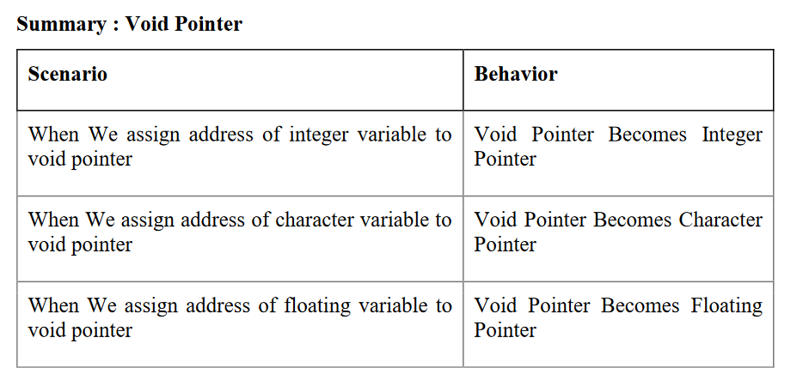
Advantages of void pointers:

Slide 58
Pointers to functions/ Function Pointers
A pointer to a function points to the address of the executable code of the function.
We can use pointers to call functions and to pass functions as arguments to other functions.
We cannot perform pointer arithmetic on pointers to functions.
The type of a pointer to a function is based on both the return type and parameter types of the function.
A declaration of a pointer to a function must have the pointer name in parentheses.
The function call operator () has a higher precedence than the dereference operator *. Without them, the compiler interprets the statement as a function that returns a pointer to a specified return type.

Slide 59
Pointers to functions/ Function Pointers
Declare Pointer to function
<function return type>(*<Pointer_name>)(function argument list)
For example:
int *f(int a); /* function f returning an int * */
In this declaration, f is interpreted as a function that takes an int as argument, and returns a pointer to an int.

Slide 60
Pointers to functions/ Function Pointers
2) double (*p2f)(double, char)
Here double is a return type of function, p2f is pointer name and (double, char) is an argument list for the function. Which means the first argument for this function should be double and the second one would be of char type

Slide 61
Pointers to functions/ Function Pointers
Example:
#include<stdio.h>
int sum (int num1, int num2)
{
return sum1+sum2;
}
int main()
{
int (*f2p) (int, int);
f2p = sum;
int op1 = f2p (10, 13);
int op2 = sum (10, 13);
printf("Output 1 – for function call via Pointer: %d",op1);
printf("Output2 – for direct function call: %d", op2);
return 0;
}

Slide 62
Pointers to functions/ Function Pointers
Output:
Output 1 – for function call via Pointer: 23
Output2 – for direct function call: 23
You would have noticed that the output of both the statements is same –
f2p(10, 13) == sum(10, 13)
which means in generic sense you can write it out as:
pointer_name(argument list) == function(same argument list)
wherein pointer_name is declared as:
return_type(*pointer_name)(argument list);
pointer_name = function_name(argument list);

Slide 63
Memory Allocation Functions
The concept of dynamic memory allocation in c language enables the C programmer to allocate memory at runtime.
Or
The process of allocating memory at runtime is known as dynamic memory allocation.
Library routines known as "memory management functions" are used for allocating and freeing memory during execution of a program. These functions are defined in stdlib.h.
Dynamic memory allocation in c language is possible by 4 functions of stdlib.h header file.
1. malloc()
2. calloc()
3. realloc()
4. free()

Slide 64
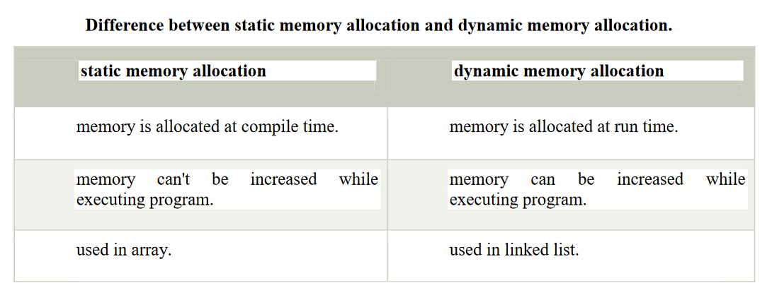
Memory Allocation Functions

Slide 65
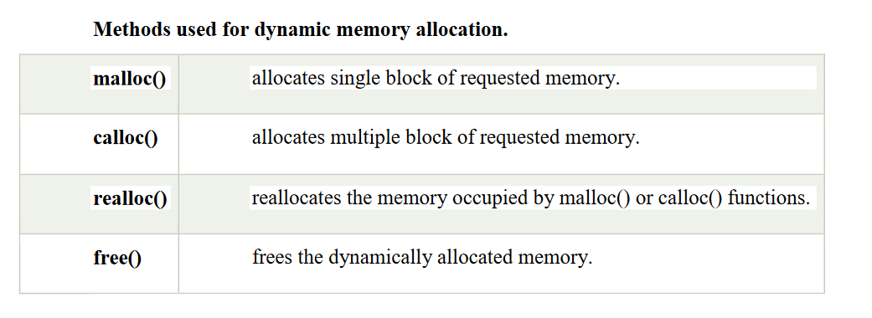
Memory Allocation Functions
Note: Dynamic memory allocation related function can be applied for any data type that's why dynamic memory allocation related functions return void*.

Slide 66
Memory Allocation Process
Global variables, static variables and program instructions get their memory in permanent storage area whereas local variables are stored in area called Stack. The memory space between these two region is known as Heap area. This region is used for dynamic memory allocation during execution of the program. The size of heap keep changing.

Slide 67
malloc()
malloc stands for "memory allocation".
The malloc() function allocates single block of requested memory at runtime. This function reserves a block of memory of given size and returns a pointer of type void. This means that we can assign it to any type of pointer using typecasting. It doesn't initialize memory at execution time, so it has garbage value initially. If it fails to locate enough space (memory) it returns a NULL pointer.
syntax
ptr=(cast-type*)malloc(byte-size)

Slide 68
malloc()
Example
int *x;
x = (int*)malloc(100 * sizeof(int)); //memory space allocated to variable x
free(x); //releases the memory allocated to variable x
This statement will allocate either 200 or 400 according to size of int 2 or 4 bytes respectively and the pointer points to the address of first byte of memory.

Slide 69
malloc()
Example
#include <stdio.h>
#include <stdlib.h>
int main()
{
int num, i, *ptr, sum = 0;
printf("Enter number of elements: ");
scanf("%d", &num);
ptr = (int*) malloc(num * sizeof(int)); //memory allocated using malloc

Slide 70
malloc()
if(ptr == NULL)
{
printf("Error! memory not allocated.");
exit(0);
}
printf("Enter elements of array: ");
for(i = 0; i < num; ++i)
{
scanf("%d", ptr + i);
sum += *(ptr + i);
}
printf("Sum = %d", sum);
free(ptr);
return 0;
}

Slide 71
calloc()
calloc stands for "contiguous allocation".
calloc() is another memory allocation function that is used for allocating memory at runtime. calloc function is normally used for allocating memory to derived data types such as arrays and structures. The calloc() function allocates multiple block of requested memory.

Slide 72
calloc()
It initially initialize (sets) all bytes to zero.If it fails to locate enough space( memory) it returns a NULL pointer. The only difference between malloc() and calloc() is that, malloc() allocates single block of memory whereas calloc() allocates multiple blocks of memory each of same size.
Syntax
ptr = (cast-type*)calloc(n/number, element-size);
calloc() required 2 arguments of type count, size-type.
count will provide number of elements; size-type is data type size

Slide 73
calloc()
Example
int*arr;
arr=(int*)calloc(10, sizeof(int)); // 20 byte
cahr*str;
str=(char*)calloc(50, sizeof(char)); // 50 byte

Slide 74
calloc()
Example
#include <stdio.h>
#include <stdlib.h>
int main()
{
int num, i, *ptr, sum = 0;
printf("Enter number of elements: ");
scanf("%d", &num);
ptr = (int*) calloc(num, sizeof(int));
if(ptr == NULL)
{
printf("Error! memory not allocated.");
exit(0);
}

Slide 75
calloc()
printf("Enter elements of array: ");
for(i = 0; i < num; ++i)
{
scanf("%d", ptr + i);
sum += *(ptr + i);
}
printf("Sum = %d", sum);
free(ptr);
return 0;
}

Slide 76
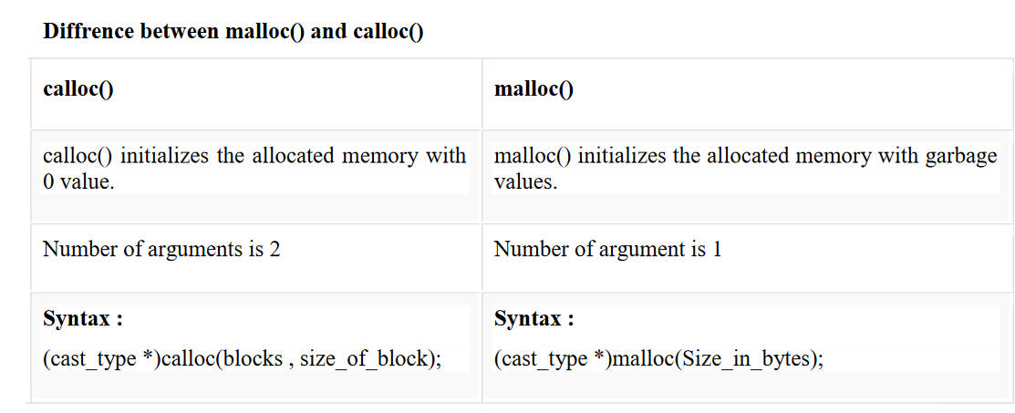
calloc() vs malloc()

Slide 77
realloc()
Changes memory size that is already allocated to a variable.
Or
If the previously allocated memory is insufficient or more than required, you can change the previously allocated memory size using realloc().

Slide 78
realloc()
If memory is not sufficient for malloc() or calloc(), you can reallocate the memory by realloc() function.
In short, it changes the memory size. By using realloc() we can create the memory dynamically at middle stage. Generally by using realloc() we can reallocation the memory.
realloc() required 2 arguments of type void*, size_type. void*will indicates previous block base address, size-type is data type size. realloc() will creates the memory in bytes format and initial value is garbage.
syntax
ptr=realloc(ptr, new-size)

Slide 79
realloc()
Example
int *x;
x=(int*)malloc(50 * sizeof(int));
x=(int*)realloc(x,100); //allocated a new memory to variable x

Slide 80
realloc()
Example:
#include <stdio.h>
#include <stdlib.h>
int main()
{
int *ptr, i , n1, n2;
printf("Enter size of array: ");
scanf("%d", &n1);
ptr = (int*) malloc(n1 * sizeof(int));
printf("Address of previously allocated memory: ");
for(i = 0; i < n1; ++i)
printf("%u\t",ptr + i);
printf("\nEnter new size of array: ");
scanf("%d", &n2);
ptr = realloc(ptr, n2);
for(i = 0; i < n2; ++i)
printf("%u\t", ptr + i);
return 0;
}

Slide 81
free()
When your program comes out, operating system automatically release all the memory allocated by your program but as a good practice when you are not in need of memory anymore then you should release that memory by calling the function free().
The memory occupied by malloc() or calloc() functions must be released by calling free() function. Otherwise, it will consume memory until program exit.
Or

Slide 82
free()
Dynamically allocated memory created with either calloc() or malloc() doesn't get freed on its own. You must explicitly use free() to release the space.
Syntax:
free(ptr);

Slide 83
free()
Example
#include <stdio.h>
#include <stdlib.h>
int main()
{
int num, i, *ptr, sum = 0;
printf("Enter number of elements: ");
scanf("%d", &num);

Slide 84
free()
ptr = (int*) malloc(num * sizeof(int)); //memory allocated using malloc
if(ptr == NULL)
{
printf("Error! memory not allocated.");
exit(0);
}
printf("Enter elements of array: ");

Slide 85
free()
for(i = 0; i < num; ++i)
{
scanf("%d", ptr + i);
sum += *(ptr + i);
}
printf("Sum = %d", sum);
free(ptr);
return 0;
}

Slide 86
Thank you….

